Slide 1

Content based Image Retrieval system
CS 510 – Foundations of computer vision Spring 2024
Srivashinie Dhamodharasamy
PSU ID: 954814608

Slide 2
Introduction
Content-Based Image Retrieval (CBIR) is a technique developed in the early 1990s for automatic image retrieval.
CBIR systems retrieve images from large databases by analyzing the visual content of the images, rather than relying on metadata or keywords.
CBIR directly examines the visual characteristics of images, such as color, texture, shape, and objects enabling more intuitive and precise image retrieval.
Computer vision is fundamental to CBIR (Content-Based Image Retrieval), offering essential algorithms and methods for extracting features, representing them, and measuring similarity.

Slide 3
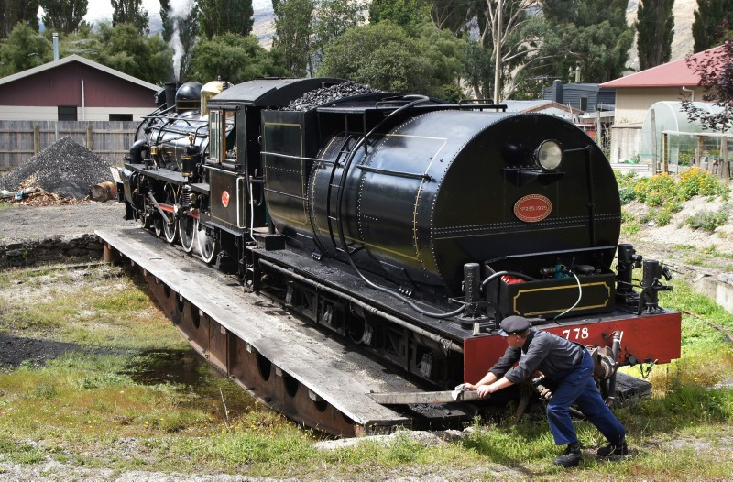


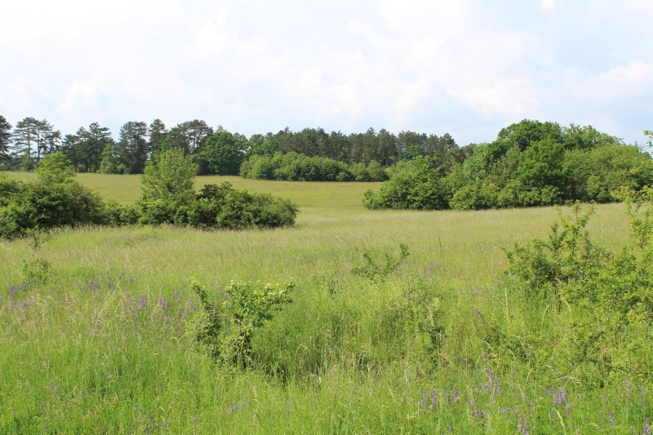

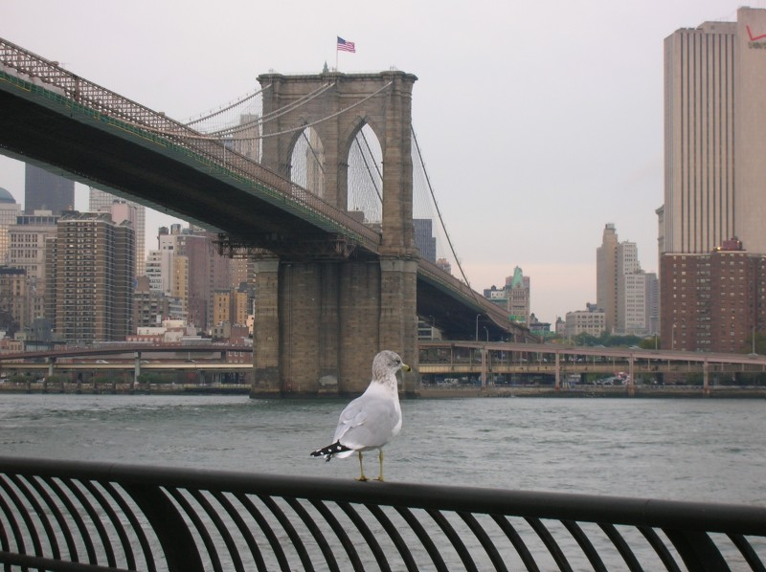
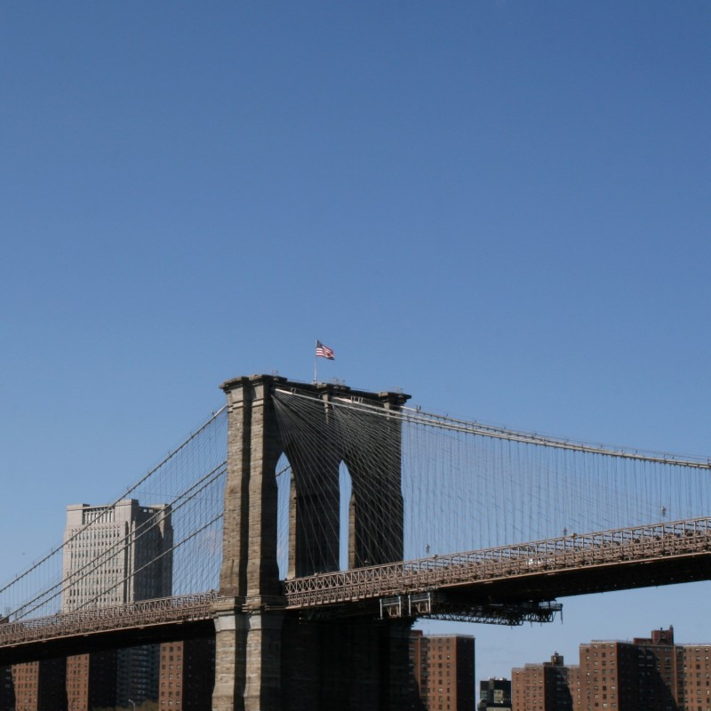

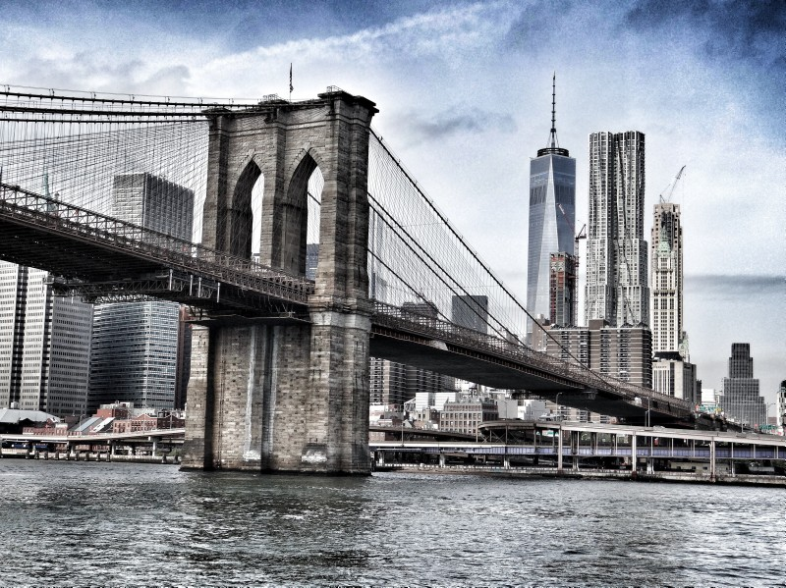
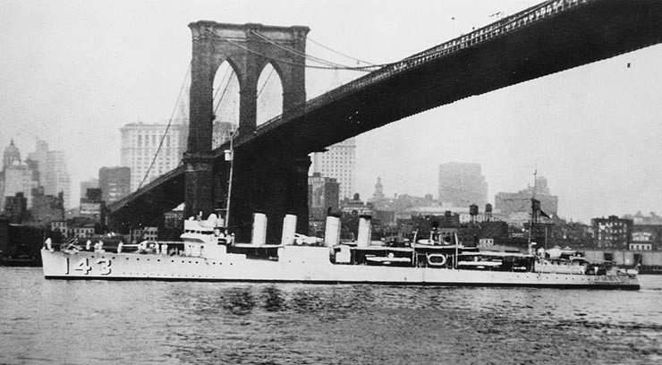
CBIR Architecture
Feature Database
0.01036,0.017448,0.01254,…
0.946162,0,0,…
0.430011,0.059489,0.163068,…
0.033133,0.000181,0,…
Feature Extraction
Feature vectors
Image Database
Feature Extraction
0.003595,0.021486,0.058124,…
Similarity Measure
Similar Images
Query Image
Query Image Feature vector

Slide 4
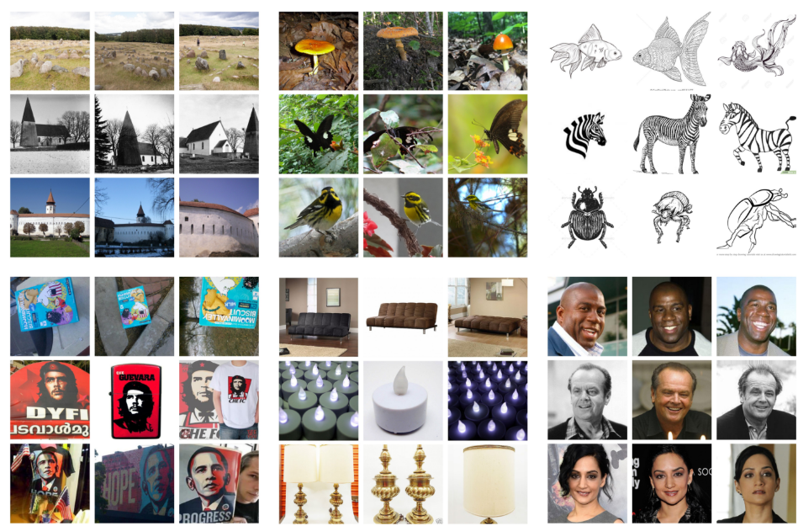
DataSET – GPR1200
The dataset comprises 12,000 images distributed across 200 classes from six diverse image domains, carefully selected and balanced.
Dataset Contents:
Google Landmarks V2: Focused on natural and architectural landmarks.
ImageNet Sketch: Black and white sketches of animals and objects.
iNat: Images of plants, animals, insects, and fungi.
INSTRE: Planar images and photographs of logos and toys.
SOP: Products and objects, partly isolated.
IMDB Faces: Images of human faces.

Slide 5
Feature Extraction
Effective Image Retrieval lies in extracting and selecting features that accurately represent the semantic content of images.
These features can be categorized into two main types:
Global Features: These features describe the overall characteristics of an entire image and include color, texture, shape, and spatial information.
Local Features: Local features are extracted from specific regions or keypoints within an image, such as corners, blobs, or edges. These features provide detailed information about localized areas of an image.

Slide 6
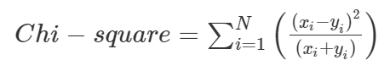
Similarity Measure
Similarity measurement determines which images are considered most relevant to the query image and should be returned from the dataset.
Distance Measure: Measures calculate the dissimilarity between two feature vectors. A smaller distance value indicates higher similarity between images.
Similarity Metric : Measures the direct similarity between feature vectors. Often involves advanced mathematical techniques and statistical methods to compare specific characteristics extracted from the images.
Similarity Measurement:
Chi-square Metric: The Chi-square metric is used to measure the dissimilarity between histogram functions.
BFMatcher (Brute Force Matcher): The BFMatcher is used for matching ORB descriptors between the query image and the dataset images. BFMatcher performs exhaustive comparisons to find the best matches for each descriptor, ensuring thorough matching.

Slide 7
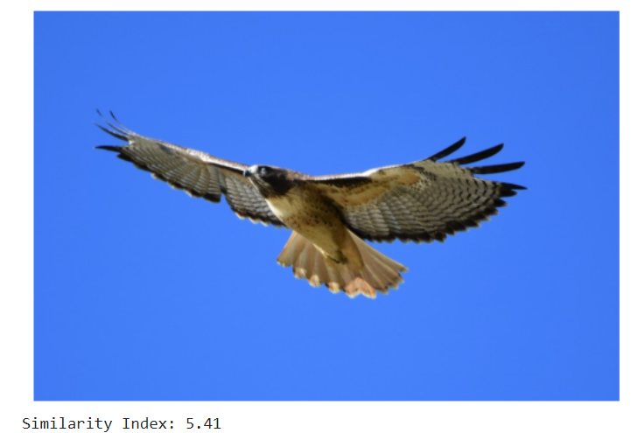
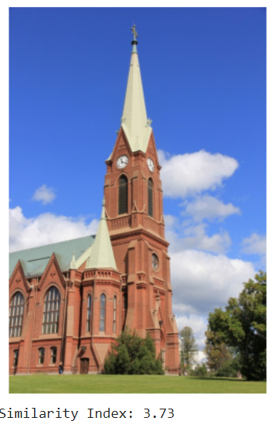
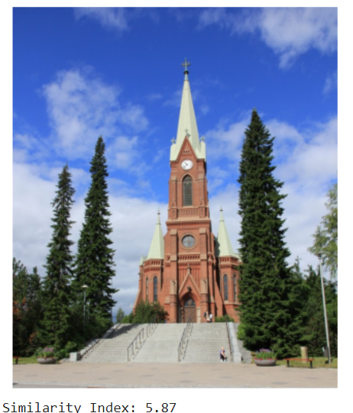
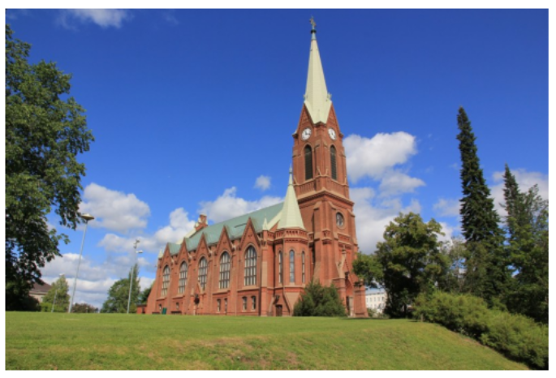
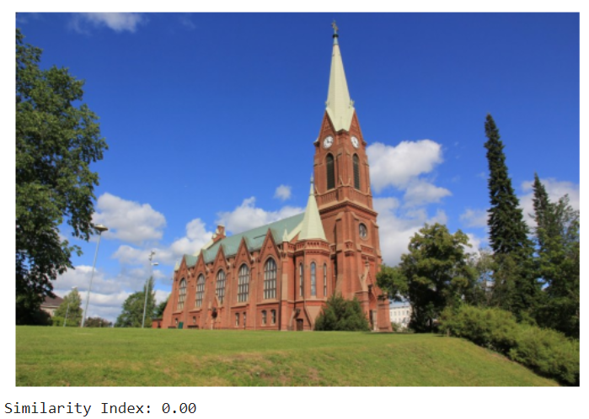
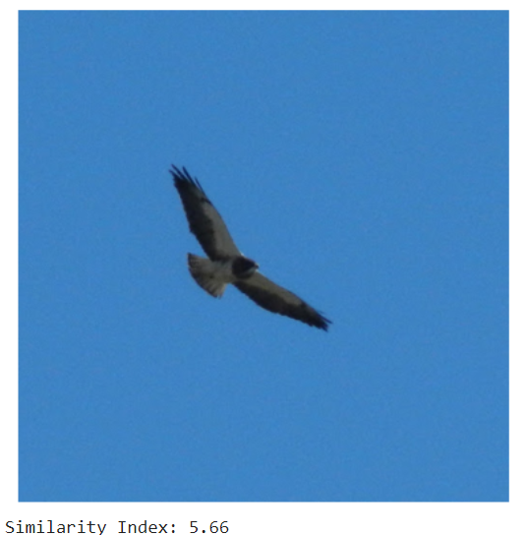
CBIR Using Color Features
Color is a fundamental and widely used low-level visual feature in CBIR, providing robustness against changes in image size and orientation and offering high expressiveness in image retrieval.
This system uses the color histogram intersection method for CBIR. It extracts HSV color features from image segments and elliptical regions, and the chi-square distance metric compares these histograms for efficient and accurate image retrieval.
Query Image

Slide 8
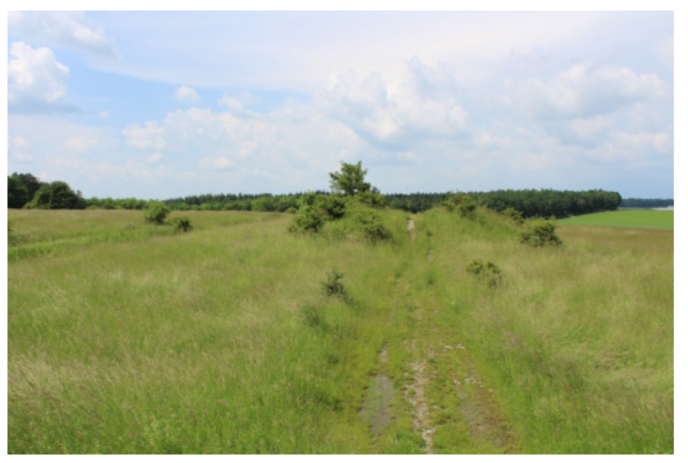
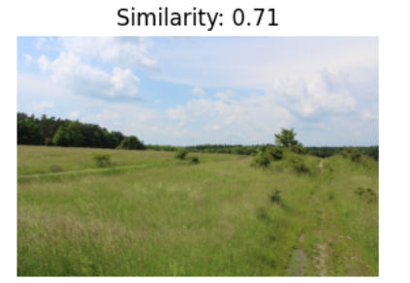
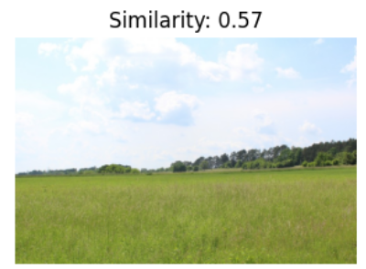
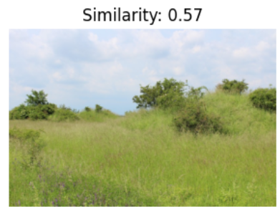
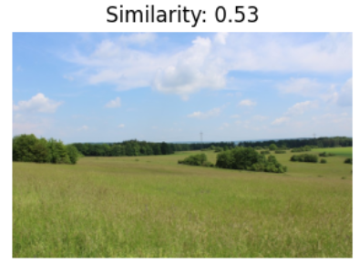
CBIR Using Combined features
System combines the ORB descriptors and color histograms to create a hybrid feature representation.
ORB Detector: Extracting local keypoint descriptors to capture distinctive features like corners, edges, and blobs.
Color Histogram: Capturing the distribution of colors within an image for overall color composition representation.
Query Image

Slide 9
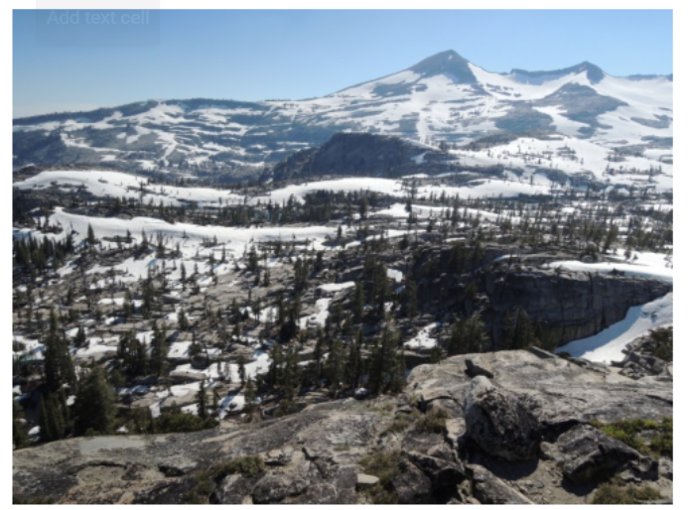
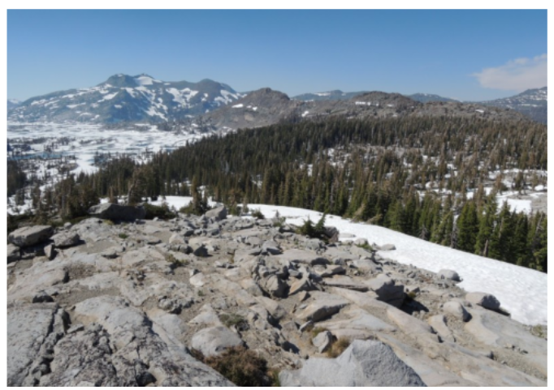
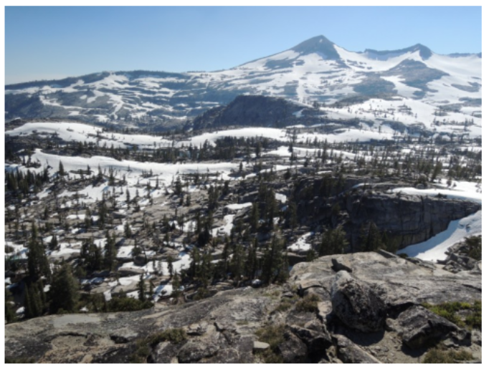
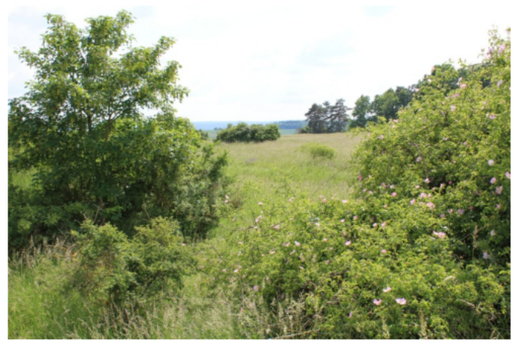
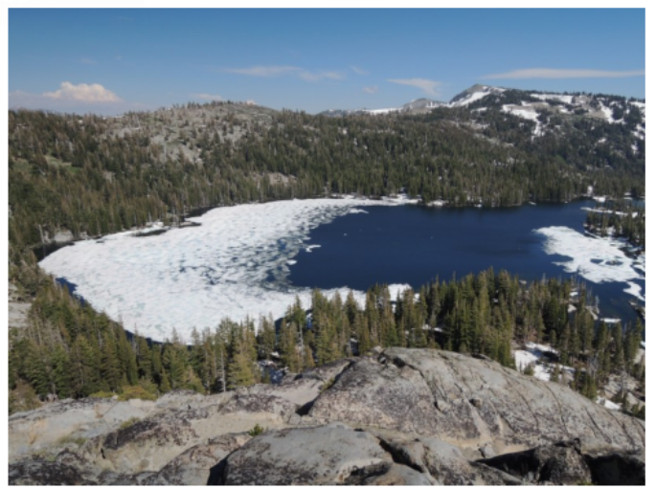
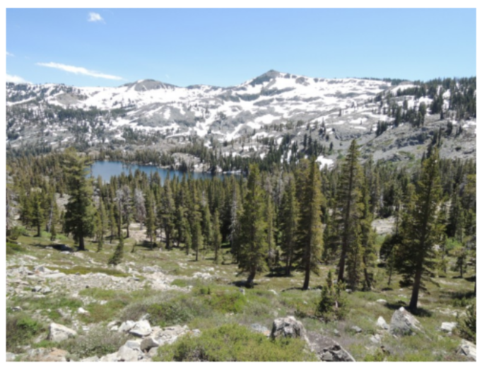
CBIR using pretrained CNN
VGG16 is a deep convolutional neural network (CNN) pre-trained on the ImageNet dataset, making it adept at extracting rich, hierarchical features from images. By using VGG16, we leverage its ability to capture intricate patterns and structures present in images.
Extracted features from VGG16 as descriptors for each image. These descriptors encode the visual characteristics of images in a high-dimensional feature space.
These query image features are then compared with the features of images in the index file using such as Euclidean distance metric.
Query Image

Slide 10
Comparison of CBIR Techniques: Color Features, Combined Features, and Pretrained CNN
Precision is the ratio of relevant images retrieved to the total number of images retrieved. In CBIR, precision is calculated by comparing the retrieved images against the ground truth relevant images.
Method | Precision | Response Time(in Seconds)
Color Features | 0.60 | 600
Combined Features | 0.80 | 960
Pretrained CNN | 0.86 | 6300

Slide 11

Applications
E-commerce: CBIR enhances online shopping by enabling users to find similar products by uploading images, improving the shopping experience.
Advertising and Marketing: CBIR aids in finding relevant images for campaigns and analyzing visual content on social media, as well as tracking the use of copyrighted images.
Healthcare: CBIR assists in diagnosing diseases like cancer by comparing medical images with a database of known images, improving diagnostic accuracy.
Art and Cultural Heritage: CBIR facilitates the search for images of artworks or artifacts based on visual features, aiding in the discovery and preservation of cultural treasures.

Slide 12
References
Schall, K., Barthel, K. U., Hezel, N., & Jung, K. (2022). GPR1200: A Benchmark for General-Purpose Content-Based Image Retrieval. In MultiMedia Modeling: 28th International Conference, MMM 2022, Phu Quoc, Vietnam, June 6–10, 2022, Proceedings, Part I (pp. 205–216). Berlin, Heidelberg: Springer-Verlag. doi:10.1007/978-3-030-98358-1_17
https://visual-computing.com/project/GPR1200
"New Approach on the Techniques of Content-Based Image Retrieval (CBIR) Using Color, Texture and Shape Features“ written by Mohd Afizi Mohd Shukran, Muhamad Naim Abdullah, Mohd Sidek Fadhil Mohd Yunus, published by Journal of Materials Science and Chemical Engineering, Vol.9 No.1, 2021
Hameed, I. M., Abdulhussain, S. H., Mahmmod, B. M., & Pham, D. T. (2021). Content-based image retrieval: A review of recent trends. Cogent Engineering, 8(1). https://doi.org/10.1080/23311916.2021.1927469
https://opencv.courses/blog/content-based-image-retrieval/
https://www.baeldung.com/cs/cbir-tbir#:~:text=Content%2DBased%20Image%20Retrieval%20(CBIR)%20is%20a%20way%20of,image%20to%20the%20database%20images.

Slide 13
Thank You!

